Slide 1
Loc Nguyen
Business Programming IS-3350
April 28, 2022

Slide 2
01
Customer Question

Slide 3
Customer Question
How can SaYoPillow improve one's sleep quality and reduce the stress associated with the following day?

Slide 4
02
Data set

Slide 5
Data set
02
Nine psychological variables:
Snoring range | Respiration range | Body temperature | Limb movement
Blood oxygen level | Eye movement | Sleep hours | Heart rate
Stress level
Notes:
The dataset provided by Rachakonda and the company contains eight psychological variables.

Slide 6
Data set
02
Stress level is measured as 5 levels:
0. Low
1. Normal stress
2. Medium stress
3. Medium-high stress
4. Extremely stress
Notes:
Stress is measured as a categorical variable with 0 being low or normal stress, 2 being medium, three medium-high stress, and four indicating high-stress levels.

Slide 7
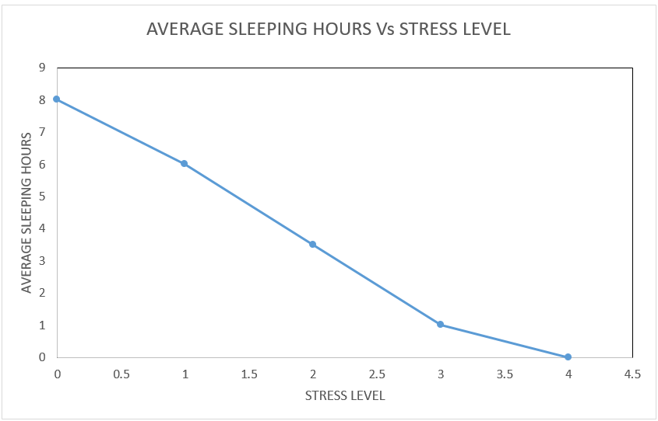
Data set
The average sleeping hours for participants was 3.7 hours. The sleeping time variable varied greatly.
02
Notes:
Based on the dataset, the average sleeping hours for participants was 3.7 hours which is below the recommended sleeping time of 7-9 hours.
The sleeping time variable varied greatly among participants, with a range of 9 hours between the highest and lowest recorded readings

Slide 8
03
Analysis

Slide 9
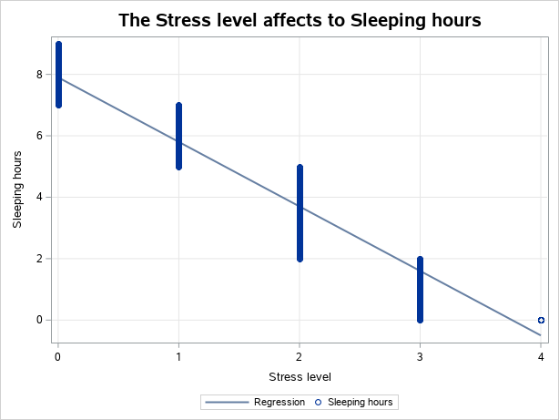
Analysis
03
Establish a relationship between the different psychological variables.
Influence people in level 1 to 4.
Notes:
According to the data file aims to materialize smart sleeping by minimizing the current and subsequent day's stress.
We need to establish a relationship between the different psychological variables recorded and an individual's stress level .
The level of stress in each frequency dramatically influences people's sleeping hours from 0 to 4 (lowest to highest). Following these, people with never stress in level 0 have slept enough seven to eight hours a day,
More slightly, people in group-level one are taken out a little time in sleep, approximately from five to seven hours a day which the stress does not affect moderately .
However, in groups 2 to 4, the stress level impacts dramatically because they suffer from high pressure from external factors that take three to five sleeping hours.

Slide 10
04
Results

Slide 11
Results
04
Analysis of Variance
Source | DF | Sum of | Mean | F Value | Pr > F
Model | 627 | 1259.98485 | 2.00955 | 265.26 | 0.0038
Error | 2 | 0.01515 | 0.00758
Corrected Total | 629 | 1260
Root MSE | 0.08
Dependent Mean | 2
R-Square | 1
Adj R=Sq | 0.99
AIC | -4812.29
AICC | .
SBC | -2652.37
1. The r-square is a factor for the decision to verify the stress level is extremely correlated with a correlation.
2. The small p-value (at a significant level of 0.05) suggests the correlation is significant.
Notes:
The respiration range shows a 0 correlation with stress level and thus should be removed to get more precise results.
Similarly, linear regression analysis conducted on the data gives us a p-value of 0, which is less than our significance level of 0.05.
Therefore, we reject the null hypothesis and conclude that not all variable means are equal.

Slide 12
05
Recommendation

Slide 13
Recommendation
05
According to Kalmbach, Anderson & Drake:
Lose sleep more stress.
Causes sleeping problems to persist.
Several recommendation:
Improvement spirit.
Do exercise
Notes:
The analysis establishes a negative relationship between sleeping hours and high-stress levels resulting in less sleep.
According to Kalmbach, Anderson & Drake (2018), losing a day's sleep due to stress leads to more stress for an individual and causes sleeping problems to persist.
As such, developing the SaYoPillow is an emerging priority as it collects psychological data and sleeping patterns, helping an individual establish how stress affects their sleep.
The technology also gives recommendations based on the individual's sleeping habits, further materializing the idea of smart sleeping.
That is to avoid stress arising, and people must find things improvement spirit because it is the inter factors that make decrease the stress level .

